Slide 1
Esters

Slide 2
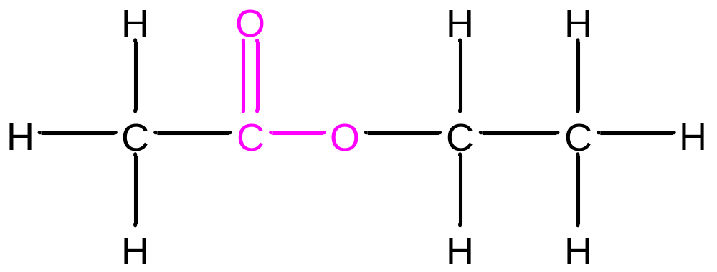
Esters
Esters have the –COO functional group.
A common example is ethyl ethanoate.
Esters are made from a condensation reaction between a
carboxylic acid and an alcohol.

Slide 3
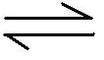
Making Esters
Carboxylic Acids reacting with alcohols
Water is formed in the reversible reaction
Sulphuric acid is normally used as a catalyst
Strong Acid Catalyst
Carboxylic acid + Alcohol Ester + Water
Ethanoic Acid + Methanol Methyl Ethanoate + Water

Slide 4
Esters are made by a condensation reaction between an alkanol (alcohol) and an alkanoic acid (carboxylic acid)
H
H
H
OH
H - C - C
H- O - C - C –H
O
H
H
H
Ethanoic acid
Ethanol

Slide 5
The easiest way to draw an ester is to draw the acid and alcohol from which it is made with their functional groups facing each other.
The OH is then removed from the acid and the H (of the OH) from the alcohol to form water.
H
H
H
OH
H- O - C - C –H
H - C - C
O
H
H
H

Slide 6
H
H
H
OH
H- O - C - C –H
H - C - C
O
H
H
H
The C of the acid has only 3 bonds and the O of the alcohol has only 1 bond. So they join.
H
H
H
H - C - C
O - C - C –H
+ H₂O
O
H
H
H
H
H
H
H - C - C
O - C - C –H
+ H₂O
O
H
H
H
Ethyl ethanoate

Slide 7
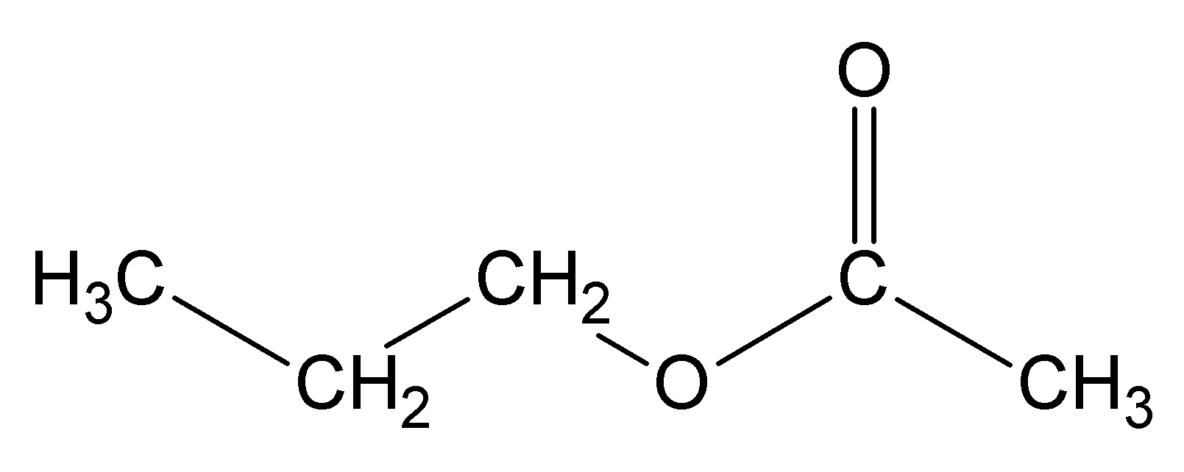

Naming Esters
First part from the alcohol
Second part from the acid
From the alcohol (propanol)
From the acid (Ethanoic Acid)

Slide 8
When naming an ester from a structure, look for the C = O of the acid.
H
O
Also look for the bond which will break
H - C – O - C - H
H
H
O
H - C – O - C - H
H
This bit of the ester came from the alcohol
This bit of the ester came from the acid
H
O
methanoic acid
methanol
H – C - O - H
H – O - C - H
H
The original ester is methyl methanoate

Slide 9
Esters are named by joining the name of the alcohol with the name of the acid.
Ethanol + ethanoic acid
Ethyl ethanoate
Propanol + ethanoic acid
Propyl ethanoate
Butanol + ethanoic acid
Butyl ethanoate
Ethanol + propanoic acid
Ethyl propanoate
Ethanol + benzoic acid
Ethyl benzoate

Slide 10
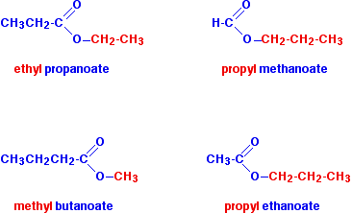

Slide 11

Esters
https://www.youtube.com/watch?v=1lP4_Rl5Jys
Why do we want esters?

Slide 12
Properties of Esters
Volatile (evaporate easily)
Sweet/ Fruity smelling (Used in perfumes and food flavourings)

Slide 13
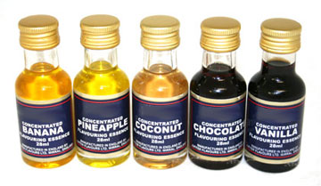
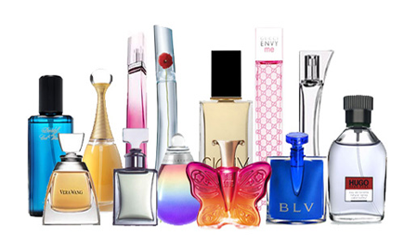
Uses of Esters
Esters are volatile, this means they have low boiling points, they have distinctive smells and tastes.
Flavourings
Perfumes

Slide 14
Ester Making
    Esters often have pleasant aromas, so are often used as perfumes or as flavourings.
    Investigate the different aromas that can be produced form the selection of alcohols and carboxylic acids present.
    Add ~1 cm³ of carboxylic acid to a test tube with ~1 cm³ of alcohol.
    Add a few drops of conc. H₂SO₄ and gently swirl.
    Place the test tube into a water bath for a few minutes.
    Tip the test tube contents into sodium carbonate solution.
    Gently waft the aroma into your nose.

Slide 15
Hydrolysis of an ester. Breaking it in to the acid and alcohol that made it by breaking the ester link and adding on the elements of water.
Ester link
O
O – C
This is where the ester breaks
The C = O bond came form the acid and the O came from the alcohol

Slide 16
Ester link
O
O – C
This is where the ester breaks
O
O
H
C
HO
The OH of water adds on to the acid
The H of water adds on to the alcohol.

